Slide 1
Field Training Management System (FTMS)

Slide 2
Instructions
Is a software application for the administration, documentation, tracking, and reporting of instructor-led-training programs. FTMS is focus on back-office processes and are considered a tool for corporate training administrators such as a training management system acts as a central enterprise resource planning (ERP) software specific to the training industry. They can be complemented by other learning technologies such as a learning management system.
During the period of university education, and in some cases in school, students in certain disciplines, such as engineering, medicine, etc., need field training. Part of the period of education in the field is considered a requirement for graduation and a certificate of study. In addition, the government in the state to train students before graduation. This training is of paramount importance; otherwise, it would not be a prerequisite for graduation from university.

Slide 3


Problem Statement
Many students in the Gaza Strip always look to find companies to training when graduation. They always want the lowest possible time to find the companies to training. On the other side, they use traditional approaches to announce training companies, also use the hardcopy to evaluate the student. Several trainees and companies recently began to use social media to search of training site. Accordingly, it would be better for both students and university to work through an organized and well-known channel to meet each other; this channel should be easy to reach and inexpensive.

Slide 4

Objectives
Project Objective:
To design and implements a field training management system FTMS
Project Sub Objectives:
To facilitate and regulate the processes of communication between trainees and trainers.
To replace all the traditional ways with modern technology
Correct orientation for the student.
Proper utilization of resources and private companies.
Enable students to create a strong opportunity to develop practical skills.
Developing students' skills in the right direction.
Facilitate and organize communication between students and training companies.

Slide 5
Project Importance
Saving time and effort.
Facilitate access to appropriate training for specialization.
Credibility and assurance of university training.
Plots of communication and communication between the student ,the trainer and university.
Ease of supervision of the student by the university.
Evaluate the student electronically on the intermediate site.
Submit a detailed report via the website about student performance and commitment.
The possibility of adopting the modern system in universities.

Slide 6
Project Scope
FTMS is an online training system that will enable students to search their training companies and services for students to facilitate the field training system. The trainers and trainees simply requires Internet connection and a computer device to log in to the FTMS online system. The students will be enable to select the training companies, send a request ,then approved the request by supervisor, and specify the deadline for each training. The project will enable trainers to add advertisements and select this advert by students and then approved the request by trainers.

Slide 7
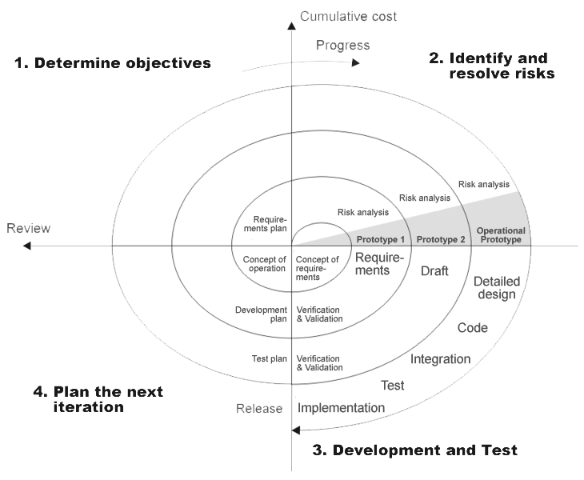
Spiral Model
The spiral model combines the idea of iterative development with the systematic, controlled aspects of the waterfall model.
Spiral model is a combination of iterative development process model and sequential linear development model i.e. waterfall model with very high emphasis on risk analysis.
It allows for incremental releases of the product, or incremental refinement through each iteration around the spiral.

Slide 8

Previous Studies
In the Previous studies system, the student uses the hardcopy system so as to receive the training field papers and requirements from the university. Afterward, the student begins his difficult journey to the training companies and institutions to find a training opportunity that may not be frequently suitable for his specialization in addition to wasting his time.

Slide 9
Functional Requirements
Functional Requirements:
Registration Management
Training Management
Evaluation Management
System Management
User Management

Slide 10
Non-Functional Requirements
Non-Functional Requirements:
Safety and Security.
Maintainability.
Portability.
Usability.
Reliability.
Availability.

Slide 11
Class Diagram
Class diagram is a type of static structure diagram that describes the structure of a system by showing the system's classes, their attributes, operations (or methods), and the relationships among objects.

Slide 12
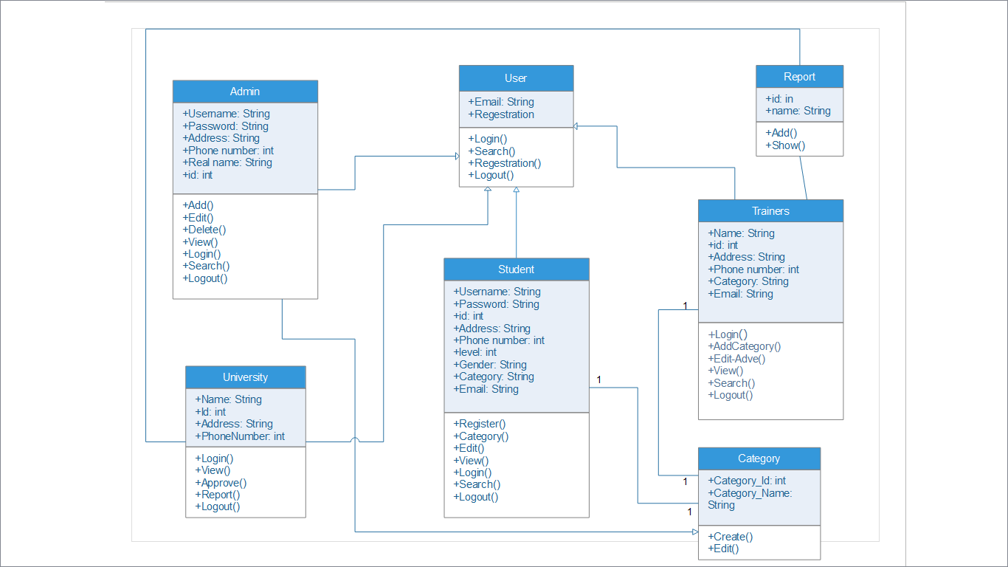

Slide 13
ERD Diagram
By using the existing tool for creating diagram in PHP my admin that shows the tables and relationships between the tables.

Slide 14
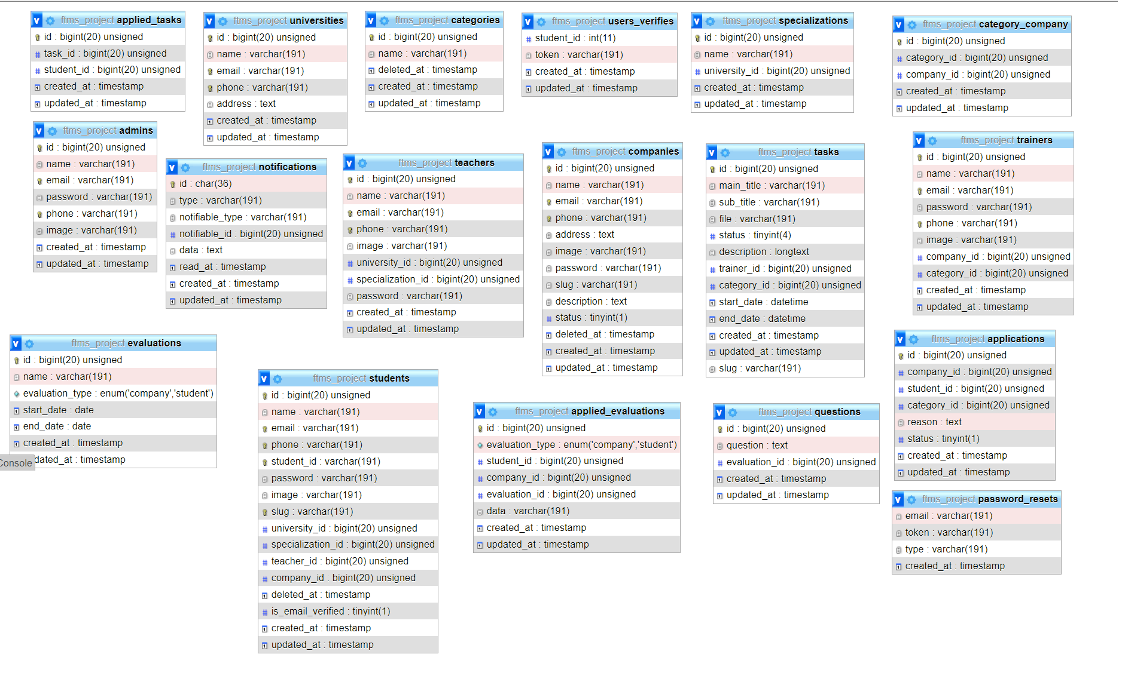

Slide 15
Interface Desing

Slide 16
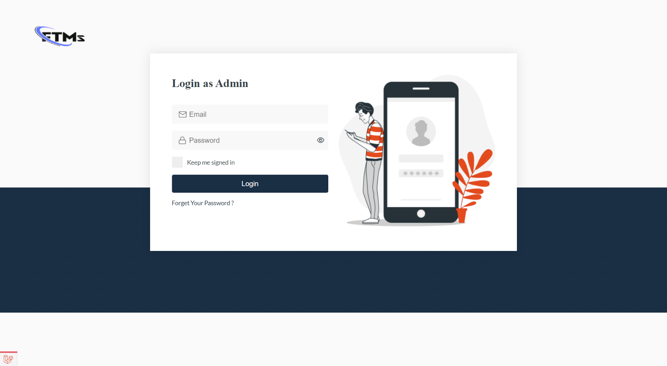
Login UI

Slide 17
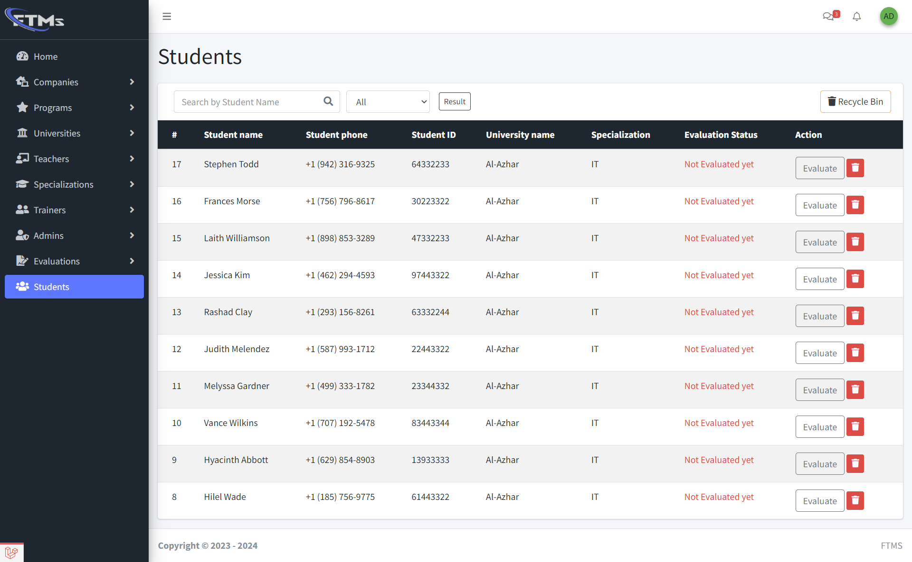
Students UI

Slide 18
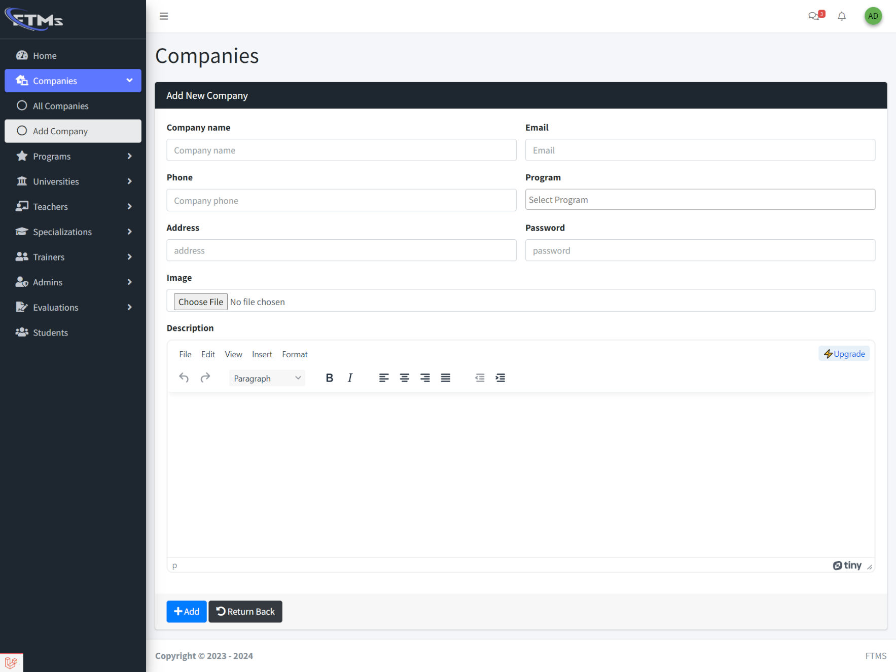
Add Company UI

Slide 19
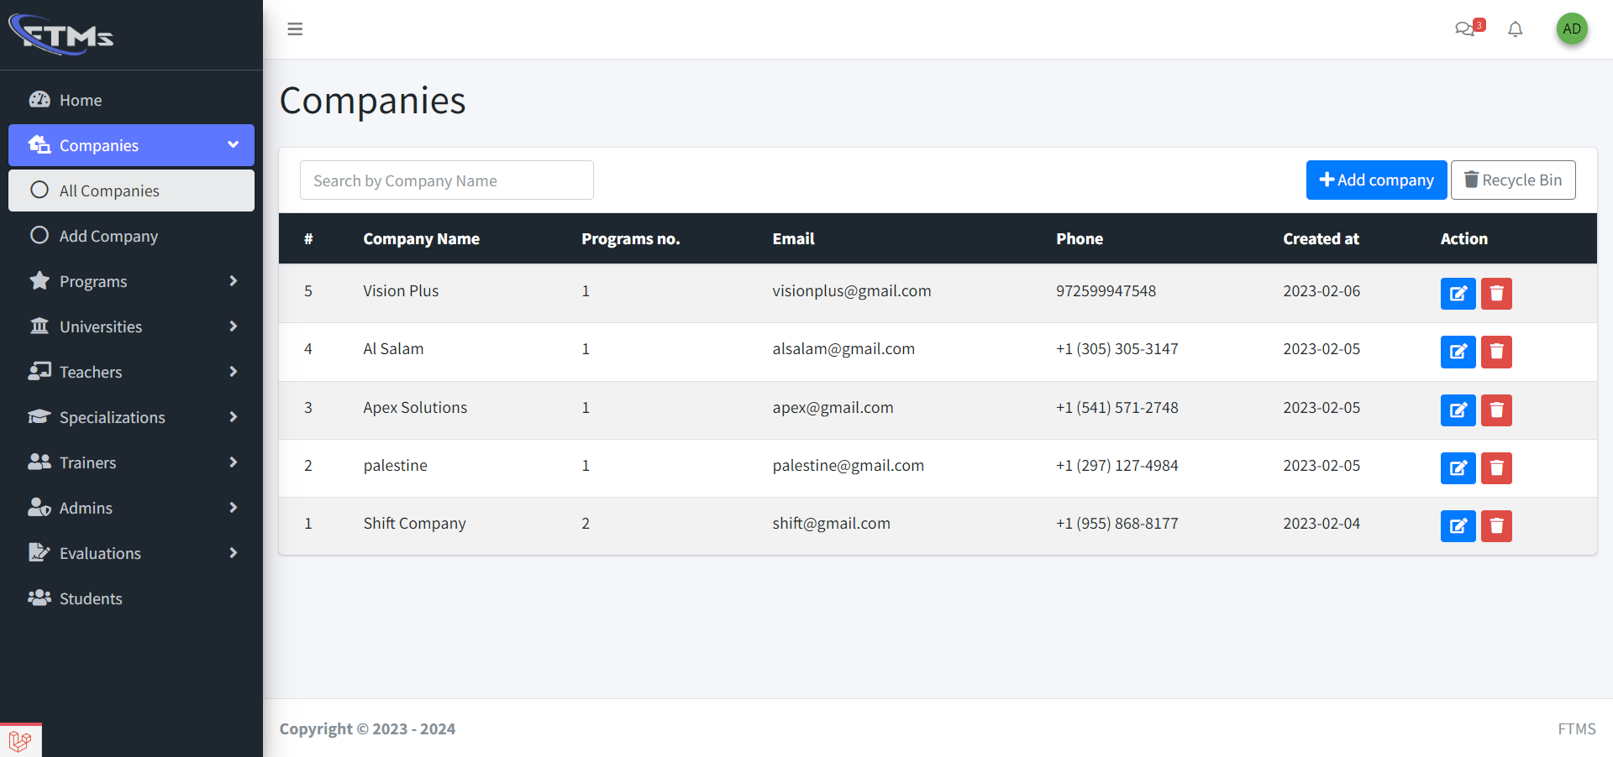
Companies UI

Slide 20
THANKS!
Esmail Al-Nbaheen
Mohanad Shahin
Mohammed Al-Baghdadi

